Slide 1

oriental College of Technology, Bhopal
Department of CSE- DATA Science
Project Proposed by:
Anubhav Tiwari (0126CD211019)
Ashmit Sharma (0126CD211030)
Bhavika Makode (0126CD211035)
Anchal Raykhere (0126CD211012)
Academic Year: 2024-2025 Session: Jan-May 2024

Slide 2
The Film Fusion

Slide 3
Presentation Outline
Introduction
Objectives
Academic Objective
Technology Strength
Proposed Idea
Social Application Requirement
Innovation and Upgradation
Software Development Lifecycle
Team Collaboration
Technical Requirements
Sample Representation

Slide 4
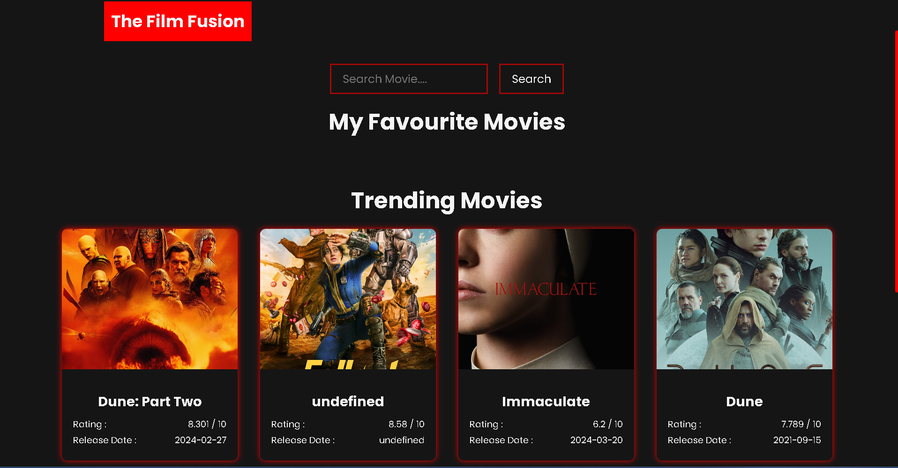
Introduction
In today's digital age, the vast array of entertainment options can often overwhelm consumers, leaving them uncertain about which movies to watch. With countless titles spanning multiple genres and languages, finding movies that align with individual preferences has become increasingly challenging. The "Film Fusion" project addresses this issue by offering a comprehensive solution for movie discovery and recommendation.
The goal of the "Film Fusion" project is to provide users with a user-friendly platform where they can easily search for movies, explore trending titles, categorize movies based on their interests, and manage their favorite selections. By integrating efficient search functionalities, aggregating trending movies, offering personalized recommendations, and enabling user interaction features and enhance the overall user experience.

Slide 5
Objectives
Provide users with a user-friendly platform for discovering movies.
Offer comprehensive details and trailers for informed decision-making.
Enhance the user experience by allowing users to add movies to favorites and view trending selections.

Slide 6
Academic Objective
Design & Development of solutions:
Design solutions for complex engineering problems and design system components or processes that meet the specified needs with appropriate consideration for the public health and safety, and the cultural, societal, and environmental considerations.
Project management and finance:
Demonstrate knowledge and understanding of the engineering and management principles and apply these to one’s own work, as a member and leader in a team, to manage projects and in multidisciplinary environments.
Individual and teamwork:
Function effectively as an individual, and as a member or leader in diverse teams, and in multidisciplinary settings.

Slide 7
Technical Strength
Utilizes HTML, CSS, and JavaScript for frontend development.
Integrates with the TMDB API for fetching movie data.
Implements local storage for saving favorite movies.
Modular Design
Security Measures
Cross-Platform compatibility
Data Management

Slide 8
Proposed Idea
The "Film Fusion" project employs a multifaceted approach to tackle the problem of movie discovery and recommendation:
Search Functionality: Users can search for movies based on keywords, titles, or genres, enabling quick and targeted discovery of relevant content.
Trending Movies: The platform aggregates trending movies from various sources, allowing users to stay updated with the latest releases and popular titles.
Personalized Recommendations: Movies are categorized based on user preferences, including genres and languages such as Bollywood, Hollywood, and Tollywood. This personalized approach enhances user experience by tailoring recommendations to individual tastes.
Favorites Management: Users can save their favorite movies, creating a curated list for future reference. This feature facilitates convenient access to preferred content and encourages user engagement.

Slide 9
Social Application Requirement
The requirements for a social application encompass a broad range of features and functionalities aimed at facilitating communication, interaction, and connection among users. Below are some key requirements for a social application requirement:
User Authentication and Registration
User Profiles
Social Networking
Messaging and Communication
Content Sharing
Interactions and Engagement
Privacy and Security
Notifications

Slide 10
Innovation or Upgradation
Advanced Recommendation Systems:
Implement advanced recommendation algorithms to suggest friends, groups, and content based on user preferences, interests, and social interactions.
Utilize machine learning techniques to continuously improve recommendation accuracy and relevance over time.
Enhanced Privacy Controls:
Provide users with granular privacy controls to manage their personal data, visibility settings, and interactions within the application.
Introduce features such as ephemeral content (e.g., disappearing messages, stories) and end-to-end encryption to enhance user privacy and security.

Slide 11



Team Collaboration
Anubhav Tiwari
Ashmit Sharma
Bhavika Makode
Anchal Raykhere
Java Script
Java Script
HTML and CSS
HTML and CSS

Slide 12


Technical Requirements
TECHNOLOGIES
TOOLS
HTML
CSS
JS (JAVA SCRIPT)
VISUAL STUDIO CODE
GIT & GITHUB
Web Browser (Any)

Slide 13
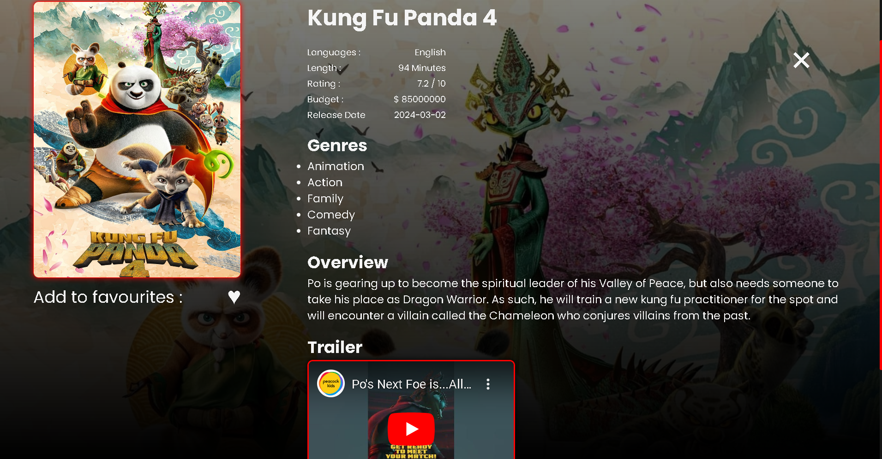
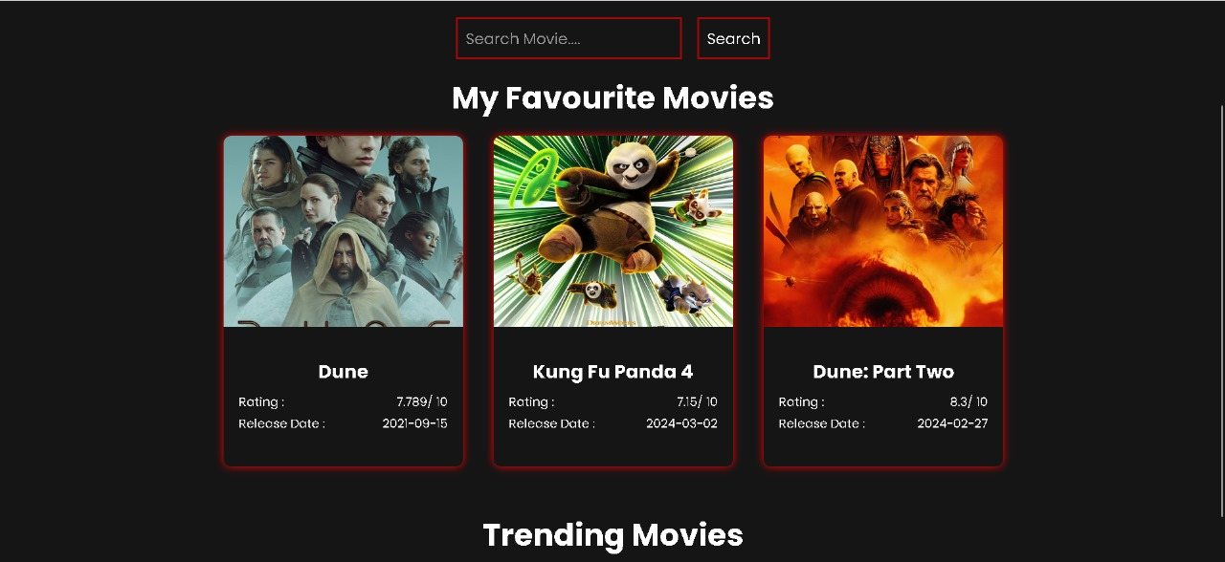
Sample Representation

Slide 14
Thank You

